Slide 1
REFLEXIVE MODELS AND EPISTEMIC APPROACH IN SOCIAL MEDIA MARKETING
Denis Fedyanin
IEEE member, Laboratory of Active Systems (V.A.Trapeznikov Institute of Control Sciences),
International Laboratory of Language, Logic and Formal Phylosophy (Higher School of Economics)

Slide 2
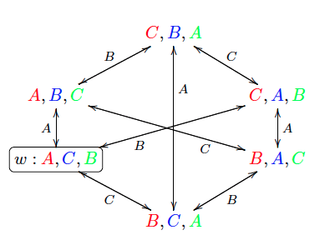
?

Slide 3
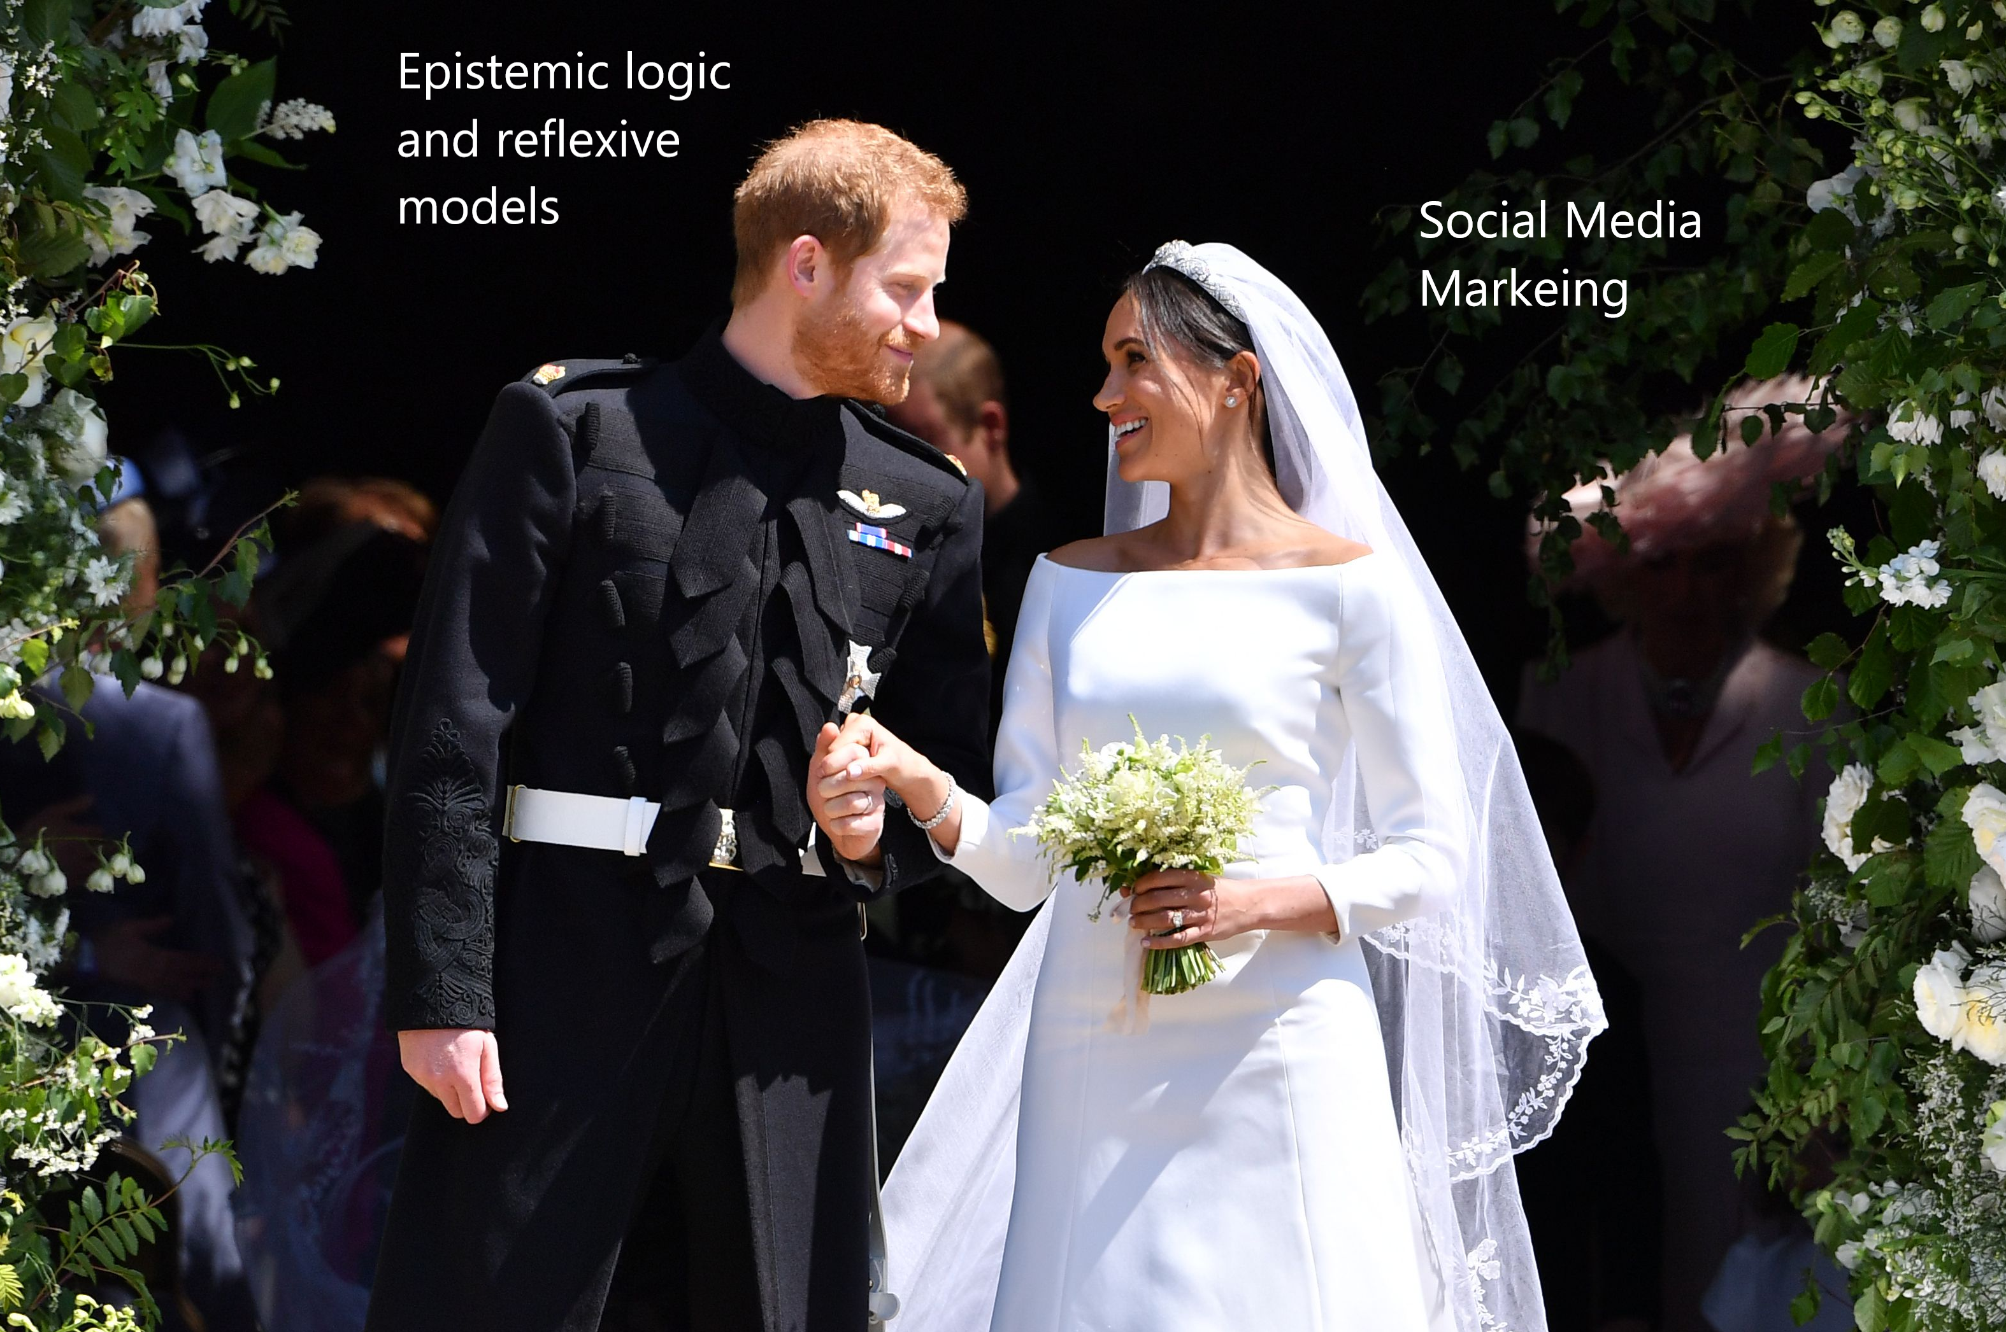
?
?

Slide 5
Fedyanin D. N., Chkhartishvili A. G. Consensus in Social Networks of Compound Nodes //Automation and Remote Control. – 2018. – Т. 79. – №. 6. – С. 1117-1124.
Fedyanin D. Model of Management of Artificial Social Network with Large Amount of Reflective Agents //2018 Eleventh International Conference" Management of large-scale system development"MLSD. – IEEE, 2018. – С. 1-5.
Giliazova A. A., Fedyanin D. N. Analysis of the Networks Growth Model with Nodes Deactivation //2018 Eleventh International Conference" Management of large-scale system development“ MLSD. – IEEE, 2018. – С. 1-3.
Fedyanin D. N. Threshold and Network generalizations of Muddy Faces Puzzle //IEEE. – 2017. – Т. 1. – С. 256-260.
Fedyanin D., Zuev A. Models of opinion control for agents in social networks // Automation and Remote Control. 2012. Vol. 73. No. 10. P. 1753-1764
Fedyanin D., Chkhartishvili A.G/ On a model of informational control in social networks // Automation and Remote Control. 2011. Vol. 72. No. 10. P. 2181-2187.

Slide 6
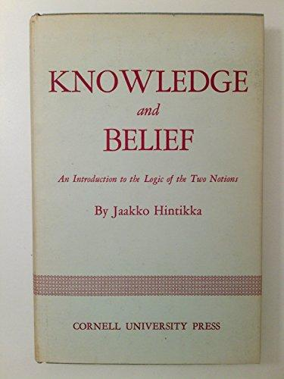
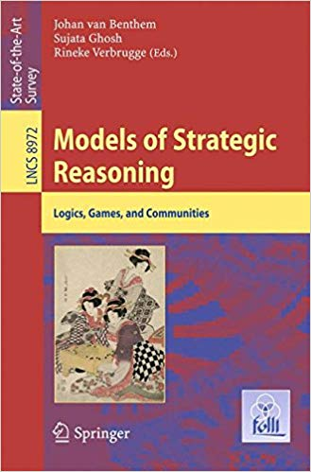

Slide 7
The term “reflection” was first suggested by J. Locke. However, in different philosophical systems (the ones by J. Locke, G. Leibniz, D. Hume, G. Hegel, etc.), reflection has various interpretations.
In psychology, systematical treatment of reflection dates back to the 1960s (V. Lefebvre’s scientific school). There are not many scientific publications treating this subject but there are a few. The distinctive feature of reflexive approach is a widely used term “phantom agent”.
There are two large and very different branches - V. Lefebvre’s scientific school and approach that was introduced and now is developing by Institute of Control Science. In this paper, we decided to use “reflexive” approach because it provided us with a simpler way of graphical visualization of dynamic. Both epistemic models based on Kripke model and models of “reflexive” approach provide tools for solving problems of epistemic planning. We also have to take into account cognitive biases [12, 13].

Slide 12
Epistemic and reflexive models
We focus on reflexive and epistemic features. The most simple and direct way is to think about it as a special graph based math tool to handle linguistic and philosophical features as “What do I know about what Alice knows what Bob knows what I knows about … Alice knows”. Similar idea could be described in humanities way not technical if we consider sych structure “What do I feel about what Alice feels what Bob feels what I feel about … Alice feel about this”.

Slide 13
A key factor in reflexive games consists in agents’ awareness (hierarchy of beliefs). Hence, its formal description involves the notion of an awareness structure –a (generally, infinite) tree whose nodes correspond to information (beliefs) of agents about essential parameters, beliefs of other agents, etc. An example of such hierarchy can be found below.
The concept of an awareness structure enables giving a formal definition to certain intuitively apprehensible notions such as adequate awareness of agent 1 about agent 2, mutual awareness, identical awareness, etc.

Slide 14
The notion of a phantom agent is a key to reflexive games analysis in this book. Let us discuss it at the qualitative level.
Suppose that two agents, namely, A and B, interact in a certain situation. Of course, each agent possesses an image of the other; agent A has an image of agent B (denoted by AB), while agent B has an image of agent A (denoted by BA). These images coincide with or differ from the reality. For instance, agent A may possess an adequate belief of agent B (the identity AB = B holds true) or may not.

Slide 17
Term “epistemic” is very widely used – one can find many publications. In this paper, we will only focus on models that are based on Kripke model and logic e.g. dynamic epistemic logic, public announcement logic etc.
In our work, we use the terms possible worlds and logical statements as synonyms in the way proposed by Aumann– the world is possible if this logical statement is true in this world.

Slide 18
Others I | What others know about myself | What others don’t know about myself
What I know about myself | I | II
What I don’t know about myself | III | IV

Slide 20
Finite awareness structures (reflexion rank equal 2) of the hero and his/her environment can be found in Fig., the components of an awareness of the hero (or about the hero) are drawn by thick lines.
We discuss the meaning of nodes in the graph demonstrated by Fig. According to the hero, the node HH corresponds to selfreflexion (the perception of his/her own “role”), the node HE corresponds to the role of the environment, and the node HEH corresponds to the hero’s role in the eyes of the environment (to the hero’s role by the normative viewpoint). By analogy, one easily characterizes nodes for the environment

Slide 21
Types of internal conflicts:
1. The mismatch between H and HH–an internal conflict between a hero and his/her beliefs about himself/herself. For instance, consider almost all literary works created by F.M. Dostoevsky (the master and wizard of self-reflexion effects); Childhood, Boyhood, and Youth by L.N. Tolstoy; all works belonging to the genre of confession, including St. Augustine Aurelius, A. Musset, J.-J. Rousseau, L.N. Tolstoy, N.A. Berdyaev, and others.
2. The mismatch between H and HEH–an internal conflict between a hero and his/her beliefs about his/her role (in the eyes of an environment). The examples are The Hero of Our Time by M.Yu. Lermontov (the character of Pechorin); The Adolescent by F.M. Dostoevsky, Father Gorio by H. de Balzaq (the character of E. de Rastignac), and others.
3. The mismatch between HH and HEH–an internal conflict between the values of an environment and a hero (according to the latter). Here the examples are Crime and Punishment, Notes from Underground, The Gambler, Demons by F.M. Dostoevsky; Princess Mary by M.Yu. Lermontov; Lady Macbeth of Mtsensk by N.S. Leskov; Lost Illussions by H. de Balzaq; most authors of marginal literature, namely, F. de Sade, H. Miller, V. Erofeev, and others.

Slide 22
Types of external conflicts:
4. The mismatch between H and EH–an external conflict between a hero and the beliefs (requirements) of an environment about him/her. For instance, Woe from Wit by A.S. Griboedov (the character of Chatsky), Notre Dame de Paris by V. Hugo; many classic literary works of Russian and foreign realism: L.N. Tolstoy (e.g., Three Deaths, The Death of Ivan Ilych, etc.), I.S. Turgenev, M.E. Saltykov-Shchedrin, J.B. Molière, P. Corneille, J. Racine, and others.
5. The mismatch between HH and EH–an external conflict between the beliefs of a hero about himself/herself and the beliefs about him/her by an environment. Here we mention Eugene Onegin by A.S. Pushkin; The Hero of Our Time by M.Yu. Lermontov (the characters of Grushnitsky and Pechorin); Rudin by I.S. Turgenev, Beltov by A.I. Herzen, and others.
6. The mismatch between EH and HEH–an external conflict between the beliefs of an environment about a hero and the vision of these beliefs by the hero. See The Inspector-General by N.V. Gogol (the character of Хлестаков); The Little Tragedies by A.S. Pushkin; Gobseck by H. de Balzaq, and others.

Slide 23
CHAPTER 1. REFLEXION IN DECISION MAKIN
1.1. Individual decision making
1.2. Interactive decision making: games and equilibria
1.3. General approaches to the description of informational and strategic reflexion
CHAPTER 2. INFORMATIONAL REFLEXION AND CONTROL
2.1. Informational reflexion in two-player games
2.2. Awareness structure of games
2.3. Informational equilibrium
2.4. Graph of a reflexive game
2.5. Regular awareness structures
2.6. Reflexion rank and informational equilibrium
2.7. Stable informational equilibria
2.8. True and false equilibria
2.9. The case of observable actions of agents
2.10. Reflexive games and bayesian games
2.11. Informational control
2.12. Modeling of informational impact
2.13. Set-type awareness structures
2.14. Transformation of awareness structure
2.15. Concordant informational control
2.16. Reflexion in planning mechanisms
CHAPTER 4. APPLIED MODELS …
4.1. Implicit control
4.2. The mass media and informational control
4.3. Reflexion in psychology
4.3.1. Playing chess
4.3.2. Transactional analysis
4.3.3. The Johari window
4.3.4. Ethical choice
4.4. Reflexion in bélles-léttres
4.5. Reflexive search games
4.6. Manufacturers and intermediate sellers
4.7. The scarcity principle
4.8. Joint production
4.9. Market competition
4.10. Lump sum payments
4.11. Sellers and buyers
4.12. Customers and executors
4.13. Corruption
4.14. Bipolar choice
4.15. Active expertise: informational reflexion
4.16. The Cournot oligopoly: informational reflexion
4.17. Resource allocation
4.18. Insurance
4.19. Product advertizing
4.20. The hustings
4.21. Rank-order tournaments
4.22. Explicit and implicit coalitions in reflexive games
4.23. Active forecast
4.24. Social networks
4.25. Mob control

Slide 25
0
V.N. Burkov
Laboratory of Active Systems

Slide 27
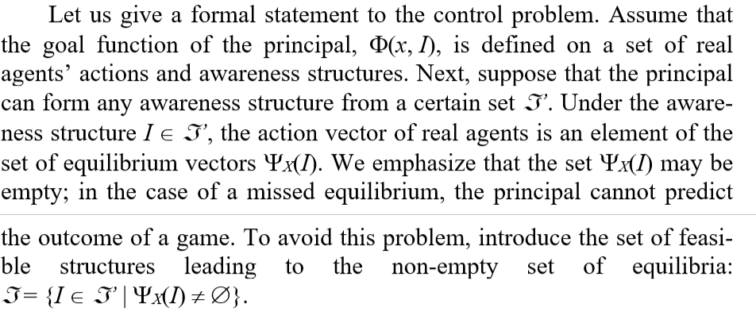

Slide 28
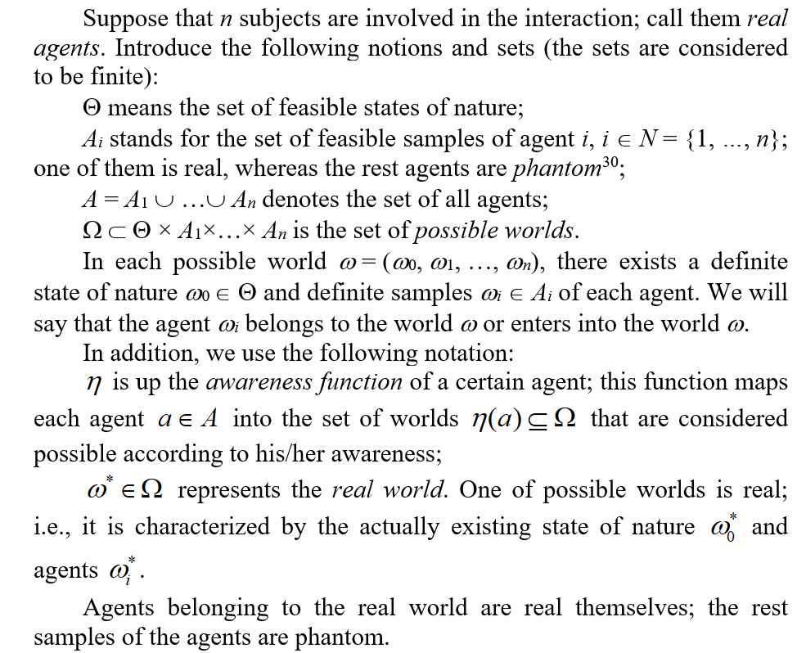

Slide 30
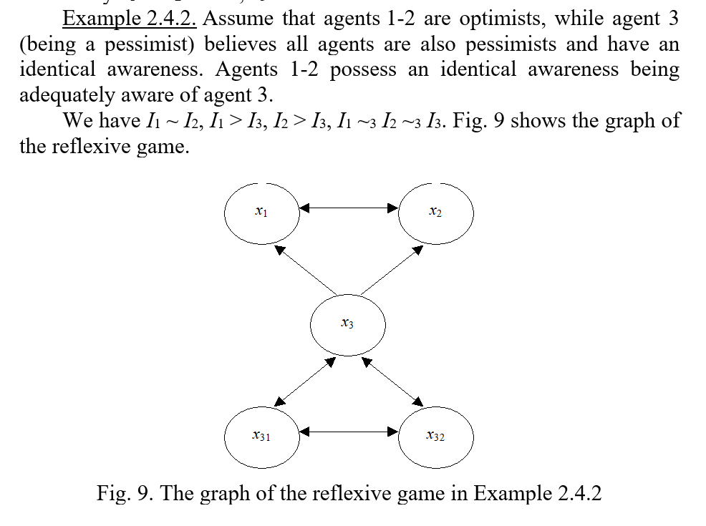

Slide 31
Social Media Marketing
Social Media Marketing (SMM) is very important part of the contemporary marketing [20]. The Basic idea lies in the fact that we cannot ignore social structure of people.
The key idea could be that any direct effect on a group of people with social structure will lead to indirect side effect of their interaction and this interaction is very complex and based of game theory mechanisms, phycology and other things. The details and the illustrations one can find in [14-17].

Slide 32
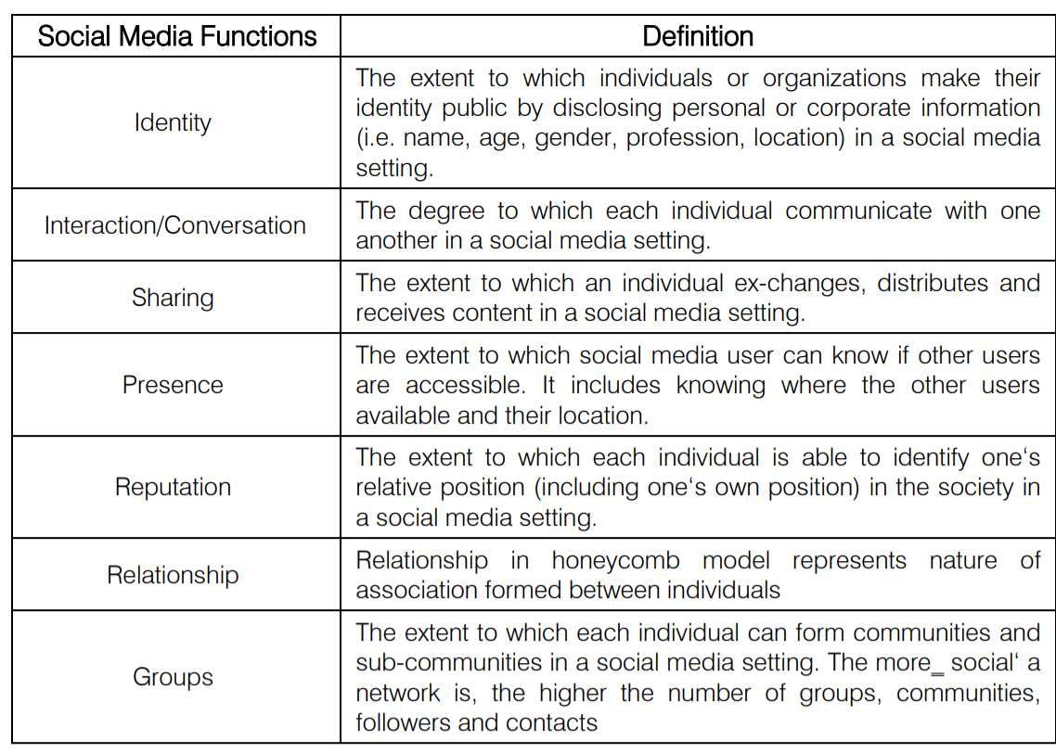
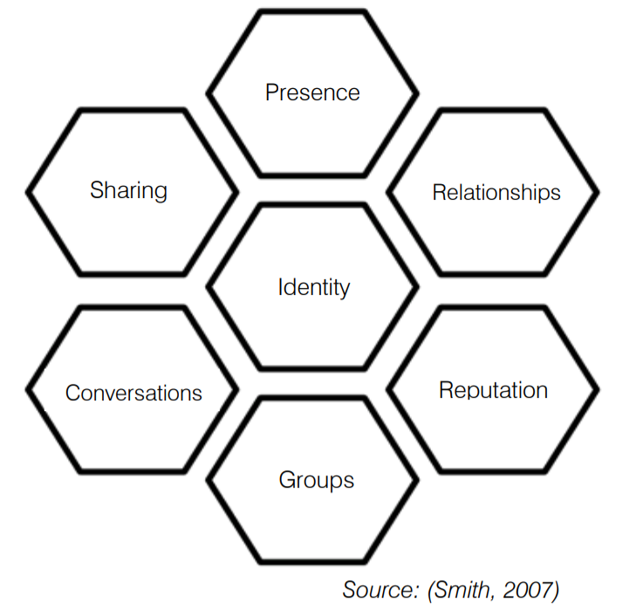

Slide 33
An example of business process of SMM activity
Preliminary phase
Analysis of market and Focus group
Analysis of Product
Analysis of KPI of marketing activities
Creating and application of marketing strategy for SMM
Creating marketing strategy for SMM
Creating focus group
Gathering a team
Creating communities if there were no
Include influential person with good reputation
Including active and famous persons to spread information
Everyday work
Observing trends
Creating content
Idea or fact
Design
Placing content
Follow up posts: analysis and commenting
Creating a report

Slide 34
Case | Example | What is a cost of our fault if we act wrong? | What do we need? | What reflexive and epistemic approaches could provide? / What kind of models suits the best?
Wars of brands | BMW vs AUDI, Democrats vs Republicans | Our reputation. | Predict next move from your opponent and reaction of our potential clients. | We can represent activity of brand owners as a game of brands. This is a rank game. That has a common idea with the “Beauty Context”game.
Reaction of clients | Victoria’s secret brand | Potential lose a part of our market | Values and reasoning, decision making of our clients | Multiple informational structure based on values of people could provide us an instrument to carefully take care of this effects.

Slide 36
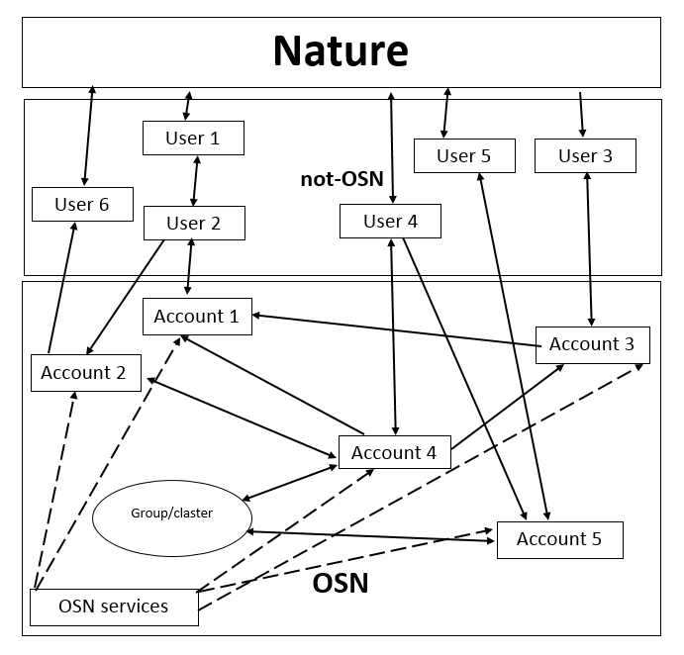
We can describe structure of this environment by a directed graph. One can easily see that this any element from E can have a link to an element from N and any element of N could have a link to an object in E. We can schematically write it as E↔N. An agent has a link to an event means that the agent is involved in this event. An event has a link to an agent then this means that an agent can receive an information from about this event or this event influences the agent.
Similar any element from N can have a link to an element from A and any element of A could have a link to an object in N. We can schematically write it as N↔A. An agent has a link to an account if and only if the agent is involved in control of this account as a member of a management team like PR agency. An account has a link to an agent if it is by a person that is associated with this account for example by name or surname.

Slide 37
Similar A could have links with G. We can schematically write it as A↔G. An account could influence group and a group could influence an account. We treat influence as a term that describes a non-empty set of situation when one can change others’ behavior or state.
An account or a group has a link to a service if he controls it. We can schematically write it as A↔S and G↔S. A service has a link to a group if it use its information or can directly influence on this account by some information or other ways.

Slide 38
 | E | N | A | G | S
Events (E) | - | takes part, producing [3] | ? | ? | provides statistics
Agents (N) | get information, is influenced | - | can use information about the certain real person like name, hobbies etc. [3] | provides expert opinions | coordinates, influences [4]
Accounts (A) | availability depends on this event | can create, controls, manages | - | provides discussions | provides statistics
Communities (G) | can be a result of public events like studying in the same school | can create, controls, manages | can take part in discussions | - | provides statistics
Services (S) | make news, gives direct link to information from nature | get information |  | ? | -

Slide 39
 | User | Why? | When? | How? | Where? | What
1 | Exists |  | Have good enough devices and time | By creating an account once | In a few network | -
2 | Is identified | Wants to spread influence | When most his friends are | By photo, identification number | In friend list and in global search | Name and photo, friends
3 | Get message | Want to find for new information | Several times a day | By signal from a device |  | Spam, new useful information.
4 | Activates | A dangerous tendency that he wants to avoid | Messages that he likes or doesn’t like | Change his opinion or get a pleasure |  | Decision rule, activity
5 | Share with others activity | With all friends | Activates too much | By using a share button |  | A post that illustrates a dangerous tendency that he wants to avoid
6 | Modify before sharing | To emphasize details |  | Adding own text |  | Posts
7 | Change behavior for (1)-(6)

Slide 40
?
?

Slide 41
?

Slide 42
Thank you

Slide 43
In a very naïve and simple way [10], one can create a model for social activity [2 ] in a OSN and close to it (pic. 1).
Let E={1, …, e} – is a set of events in a nature that we take into account, N={1,…, n} – a set of agents, A={1,…a} – a set of OSN accounts, G={1,…, g} – a set of groups, news groups communities and others similar communities in OSN that are subsets of A. Let S = {1, …, s} - are services of OSN.

Slide 44
Consider a model, where an agent purchases a certain product based on his/her preferences and on the information about the share of other agents planning such purchase. Interestingly, most advertising campaigns can be described by the model of informational control with agents’ Reflexion of rank 1 or 2.
Suppose that there are agents of two types. The ones having type 1 incline to purchase products regardless of advertising, while agents of type 2 would not. Denote by θ ∈ [0; 1] the share of type 1 agents. Type 2 agents (their share makes up (1–θ)) are subject to advertising effect; however, they do not comprehend this. Let us reflect social impact as follows. Assume that type 2 agents choose the action a with the probability p(θ) and the action the action r with the probability 1 – p(θ). The relationship p(⋅) (the choice probability as a function of the share of type 1 agents) characterizes their reluctance of being contrarians.
Imagine that the actual share θ of type 1 agents forms a common knowledge. Then agents expect that θ agents purchase the product. Nevertheless, in reality they observe that the product is purchased by
(1) x(θ) = θ + (1 – θ) p(θ)
agents (by supposition, agents do not realize the advertising effect). Since ∀ θ ∈ [0; 1]: θ ≤ x(θ), the indirect social impact becomes assuring: “Look, more people incline to purchase the product than we expected!”

Slide 45
To proceed, we analyze an asymmetrical awareness. Type 1 agents choose their actions independently. Thus, they can be treated as having an adequate awareness about the parameter θ and the beliefs of type 2 agents.
Consider the model of informational regulation, where a principal (an organizer of an advertizing campaign) forms the beliefs θ₂ about the parameter θ for type 2 agents.
Making a small digression, discuss the properties of the function p(θ). Suppose that p(⋅) is a nondecreasing function on [0; 1] such that p(0) = ε, p(1) = 1 – γ . Here ε and δ indicate constants belonging to unit segment, ε ≤ 1 – δ. In practical interpretation, ε corresponds to “mistakes” of some type 2 agents (they purchase the product, even believing that the rest agents have type 2). The constant δ characterizes (in a certain sense) agents’ susceptibility to influence. Indeed, a type 2 agent has a chance to be independent (by refusing to purchase, even if he/she believes that the rest agents will purchase the product). The special case of ε = 0, δ = 1 describes independent agents of type 2 (who deny the purchase).

Slide 46
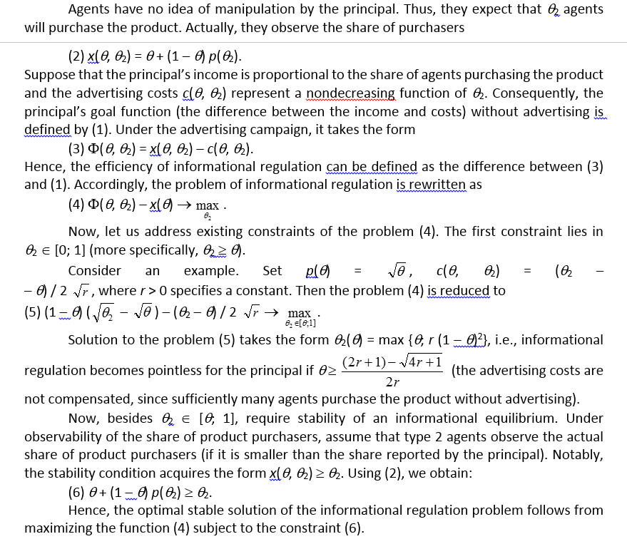

Slide 47
Thank you again

Slide 48
Part 1 Introduction

Slide 51
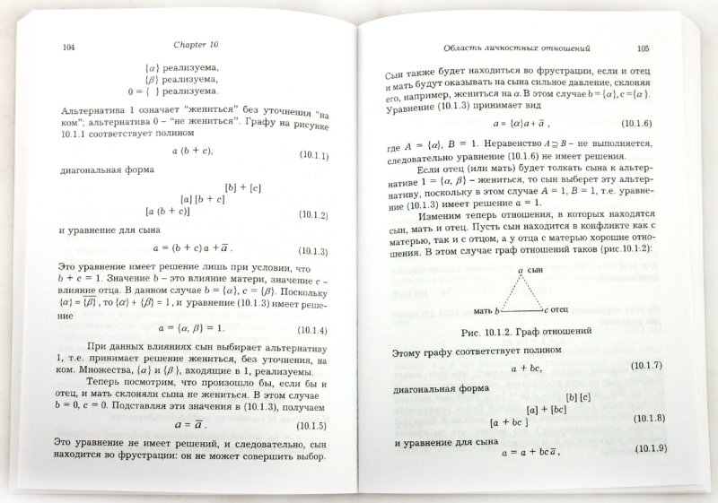
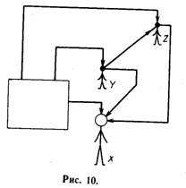
Reflection [of representations]

Slide 52
0
V.N. Burkov
Laboratory of Active Systems

Slide 57
CHAPTER 1. REFLEXION IN DECISION MAKIN
1.1. Individual decision making
1.2. Interactive decision making: games and equilibria
1.3. General approaches to the description of informational and strategic reflexion
CHAPTER 2. INFORMATIONAL REFLEXION AND CONTROL
2.1. Informational reflexion in two-player games
2.2. Awareness structure of games
2.3. Informational equilibrium
2.4. Graph of a reflexive game
2.5. Regular awareness structures
2.6. Reflexion rank and informational equilibrium
2.7. Stable informational equilibria
2.8. True and false equilibria
2.9. The case of observable actions of agents
2.10. Reflexive games and bayesian games
2.11. Informational control
2.12. Modeling of informational impact
2.13. Set-type awareness structures
2.14. Transformation of awareness structure
2.15. Concordant informational control
2.16. Reflexion in planning mechanisms
CHAPTER 4. APPLIED MODELS …
4.1. Implicit control
4.2. The mass media and informational control
4.3. Reflexion in psychology
4.3.1. Playing chess
4.3.2. Transactional analysis
4.3.3. The Johari window
4.3.4. Ethical choice
4.4. Reflexion in bélles-léttres
4.5. Reflexive search games
4.6. Manufacturers and intermediate sellers
4.7. The scarcity principle
4.8. Joint production
4.9. Market competition
4.10. Lump sum payments
4.11. Sellers and buyers
4.12. Customers and executors
4.13. Corruption
4.14. Bipolar choice
4.15. Active expertise: informational reflexion
4.16. The Cournot oligopoly: informational reflexion
4.17. Resource allocation
4.18. Insurance
4.19. Product advertizing
4.20. The hustings
4.21. Rank-order tournaments
4.22. Explicit and implicit coalitions in reflexive games
4.23. Active forecast
4.24. Social networks
4.25. Mob control

Slide 60
A key factor in reflexive games consists in agents’ awareness (hierarchy of beliefs). Hence, its formal description involves the notion of an awareness structure –a (generally, infinite) tree whose nodes correspond to information (beliefs) of agents about essential parameters, beliefs of other agents, etc. An example of such hierarchy can be found below.
The concept of an awareness structure enables giving a formal definition to certain intuitively apprehensible notions such as adequate awareness of agent 1 about agent 2, mutual awareness, identical awareness, etc.
The notion of a phantom agent is a key to reflexive games analysis in this book. Let us discuss it at the qualitative level.
Suppose that two agents, namely, A and B, interact in a certain situation. Of course, each agent possesses an image of the other; agent A has an image of agent B (denoted by AB), while agent B has an image of agent A (denoted by BA). These images coincide with or differ from the reality. For instance, agent A may possess an adequate belief of agent B (the identity AB = B holds true) or may not.
The following question rises immediately. Is the identity AB = B possible in principle? You know, B represents a real agent, whereas AB is merely his/her image! This philosophical question requires going into subtleties; let us merely emphasize a couple of important facts. First, the matter concerns modeling of individual behavior in a specific situation rather than complete understanding of an individual. During everyday communication with different people, we often face situations of adequate and inadequate perception of an individual by other individuals.

Slide 61
Describe formally possible cases of the mutual awareness of two subjects, “Hero” and “Environment.” Denote them by “H” and “E,” respectively.
In addition, we introduce the following system of symbols: H–nonreflexive beliefs of a hero about an objective reality (all except the hero and his/her environment); E–nonreflexive beliefs on the environment about an objective reality. The hero and his/her environment represent real agents, whereas the following agents are phantom: HH–the beliefs of the hero about himself/herself; HE–the beliefs of the hero about the environment; HEH–the beliefs of the hero about the beliefs of the environment about him/her; EE–the beliefs of the environment about itself; EH–the beliefs of the environment about the hero; EHE–the beliefs of the environment about the beliefs of the hero about the environment.
Practical interpretations of HHE, HHH, HEE, EEE, EEH, EHH seem difficult.

Slide 62
Types of internal conflicts:
1. The mismatch between H and HH–an internal conflict between a hero and his/her beliefs about himself/herself. For instance, consider almost all literary works created by F.M. Dostoevsky (the master and wizard of self-reflexion effects); Childhood, Boyhood, and Youth by L.N. Tolstoy; all works belonging to the genre of confession, including St. Augustine Aurelius, A. Musset, J.-J. Rousseau, L.N. Tolstoy, N.A. Berdyaev, and others.
2. The mismatch between H and HEH–an internal conflict between a hero and his/her beliefs about his/her role (in the eyes of an environment). The examples are The Hero of Our Time by M.Yu. Lermontov (the character of Pechorin); The Adolescent by F.M. Dostoevsky, Father Gorio by H. de Balzaq (the character of E. de Rastignac), and others.
3. The mismatch between HH and HEH–an internal conflict between the values of an environment and a hero (according to the latter). Here the examples are Crime and Punishment, Notes from Underground, The Gambler, Demons by F.M. Dostoevsky; Princess Mary by M.Yu. Lermontov; Lady Macbeth of Mtsensk by N.S. Leskov; Lost Illussions by H. de Balzaq; most authors of marginal literature, namely, F. de Sade, H. Miller, V. Erofeev, and others.

Slide 63
Types of external conflicts:
4. The mismatch between H and EH–an external conflict between a hero and the beliefs (requirements) of an environment about him/her. For instance, Woe from Wit by A.S. Griboedov (the character of Chatsky), Notre Dame de Paris by V. Hugo; many classic literary works of Russian and foreign realism: L.N. Tolstoy (e.g., Three Deaths, The Death of Ivan Ilych, etc.), I.S. Turgenev, M.E. Saltykov-Shchedrin, J.B. Molière, P. Corneille, J. Racine, and others.
5. The mismatch between HH and EH–an external conflict between the beliefs of a hero about himself/herself and the beliefs about him/her by an environment. Here we mention Eugene Onegin by A.S. Pushkin; The Hero of Our Time by M.Yu. Lermontov (the characters of Grushnitsky and Pechorin); Rudin by I.S. Turgenev, Beltov by A.I. Herzen, and others.
6. The mismatch between EH and HEH–an external conflict between the beliefs of an environment about a hero and the vision of these beliefs by the hero. See The Inspector-General by N.V. Gogol (the character of Хлестаков); The Little Tragedies by A.S. Pushkin; Gobseck by H. de Balzaq, and others.

Slide 64
This book is dedicated to
1. Modern approaches to mathematical modeling of reflexive processes in control. The authors consider reflexive games that describe the interaction of subjects (agents) making decisions based on an hierarchy of beliefs regarding
essential parameters (informational reflexion),
decision principles used by opponents (strategic reflexion),
beliefs about beliefs, and so on.
2. Analyzing the behavior of phantom agents (existing in beliefs of other real or phantom agents) and the properties of informational and reflexive structures (reflecting the mutual awareness of real and phantom agents) enables suggesting informational and reflexive equilibria as solutions of corresponding games. The mentioned equilibria generalize a series of well-known equilibrium concepts in noncooperative games and models of collective behavior.

Slide 65
The models of informational and strategic reflexion allow:
Describing and studying the behavior of reflexing subjects;
Investigating the relationship between payoffs gained by agents and their reflexion ranks;
suggesting and solving the problems of informational and reflexive control in organizational, economic, social and other systems, in military applications, etc. (an interested reader would find in the book over 30 examples of possible applications in these fields);
describing uniformly many phenomena connected with reflexion, viz., implicit control, informational control via the mass media, reflexion in psychology, art works, etc.

Slide 66
Part 2
Formal definitions and results

Slide 67
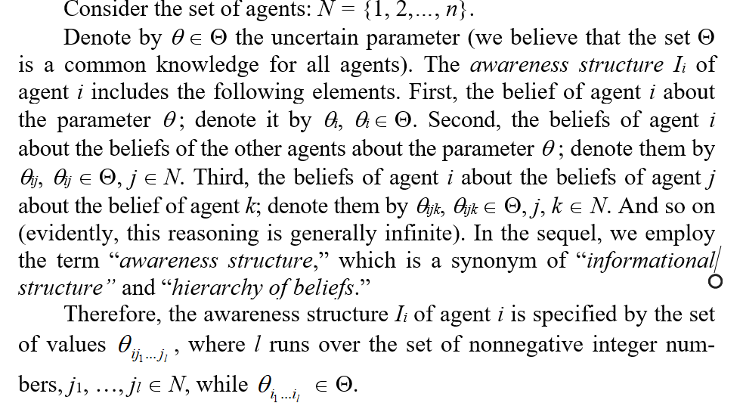

Slide 68
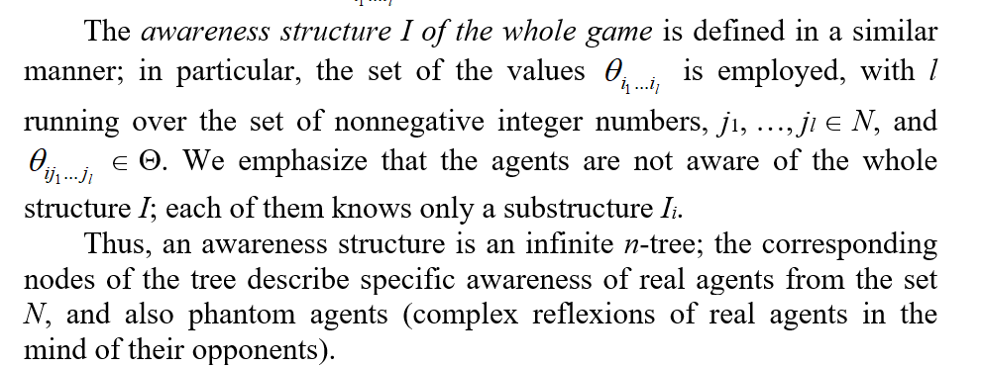

Slide 69
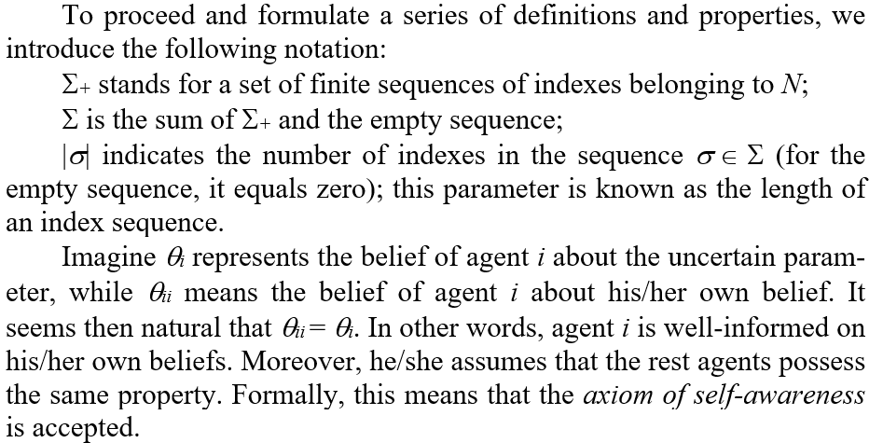

Slide 70
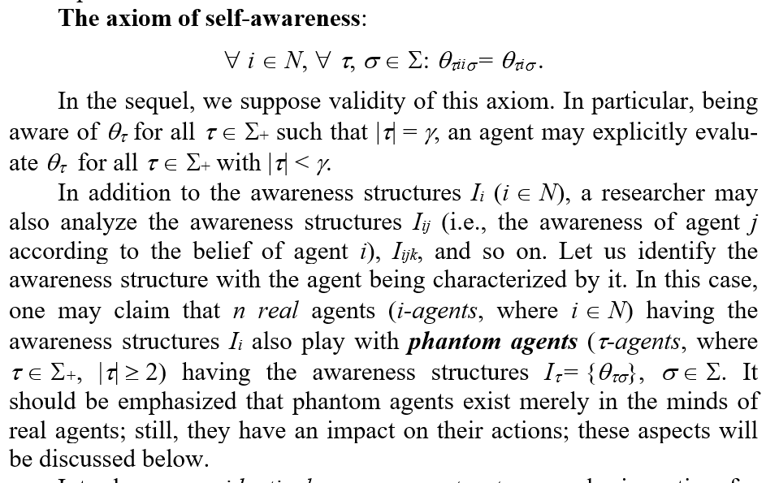

Slide 72
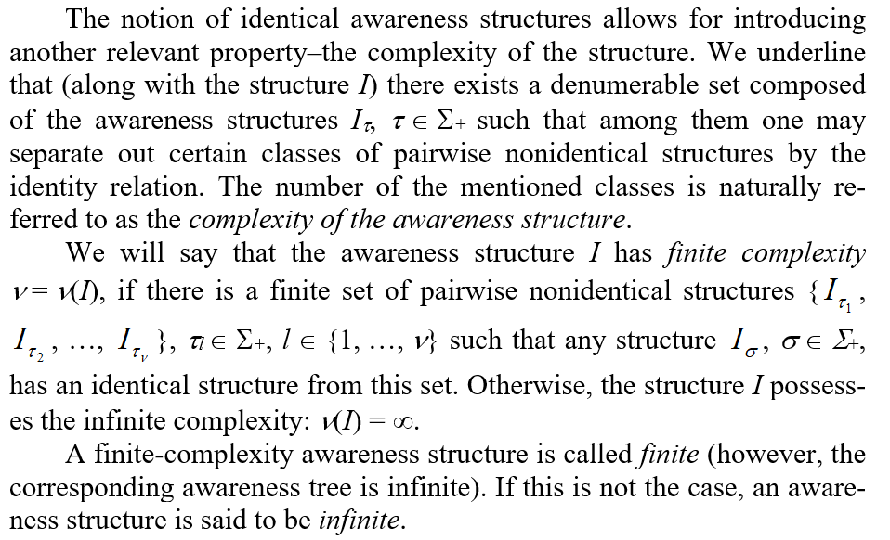

Slide 73
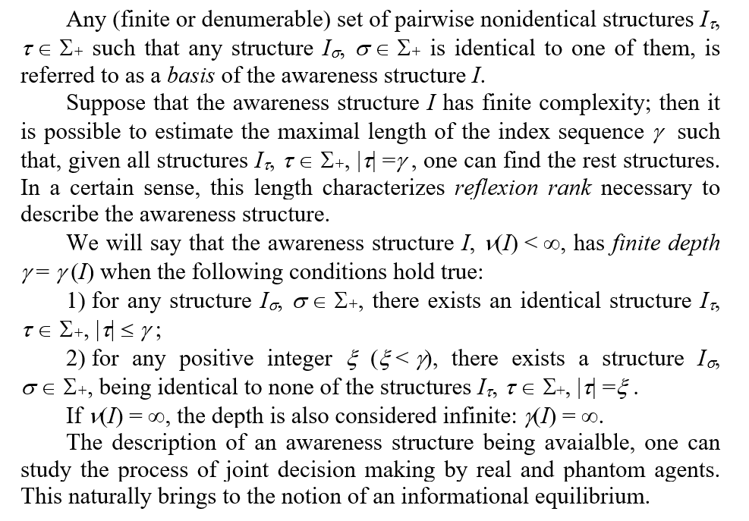

Slide 75
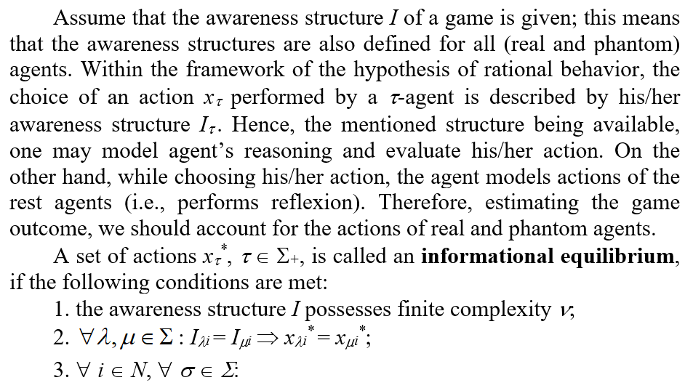

Slide 76
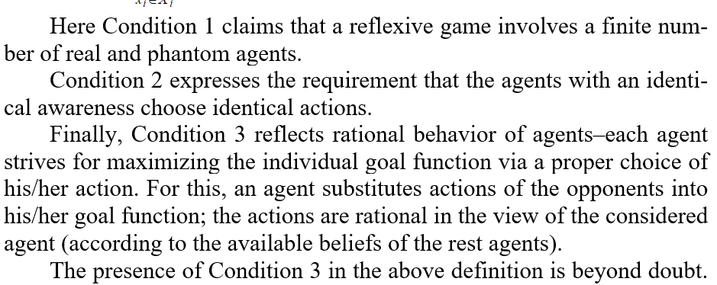

Slide 77
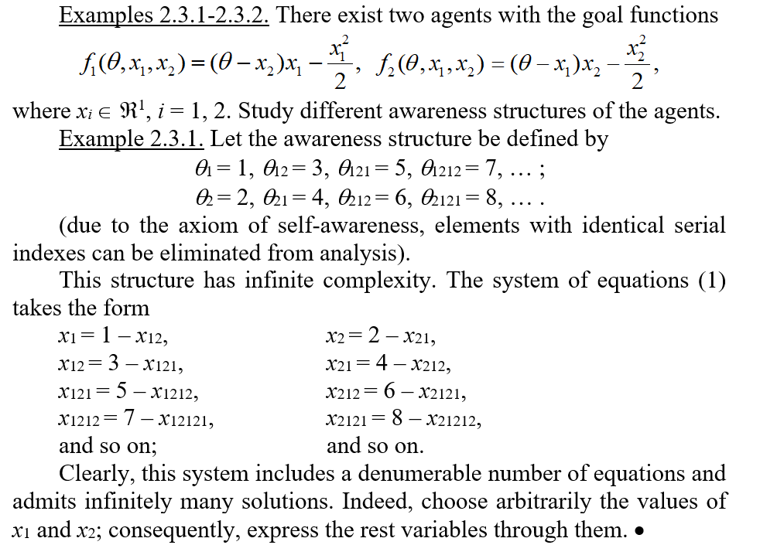

Slide 78
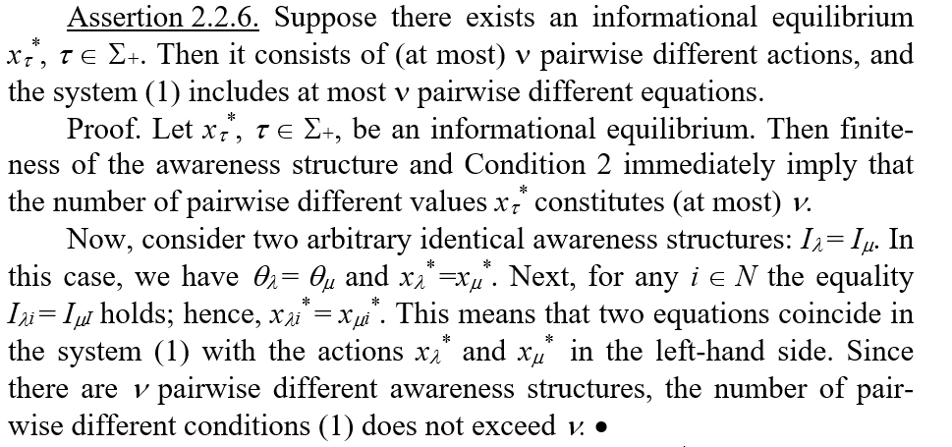

Slide 79
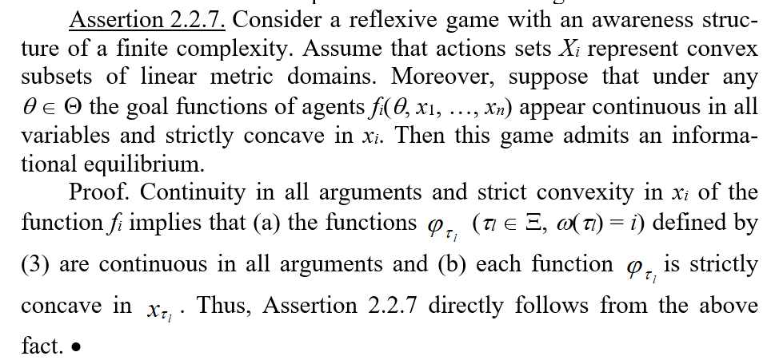

Slide 80
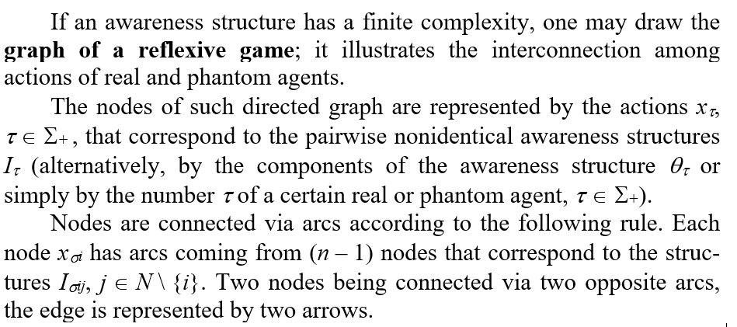

Slide 81
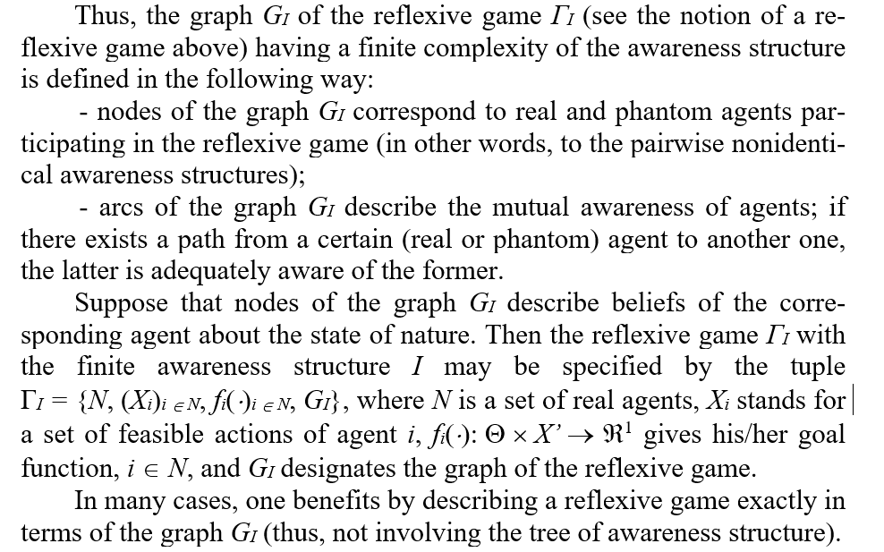

Slide 84
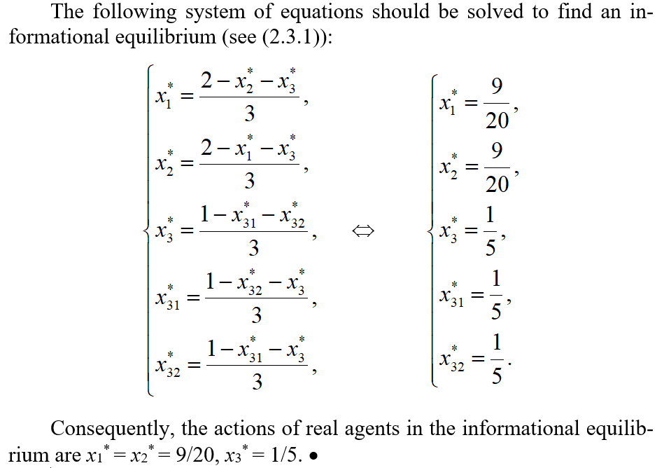

Slide 85
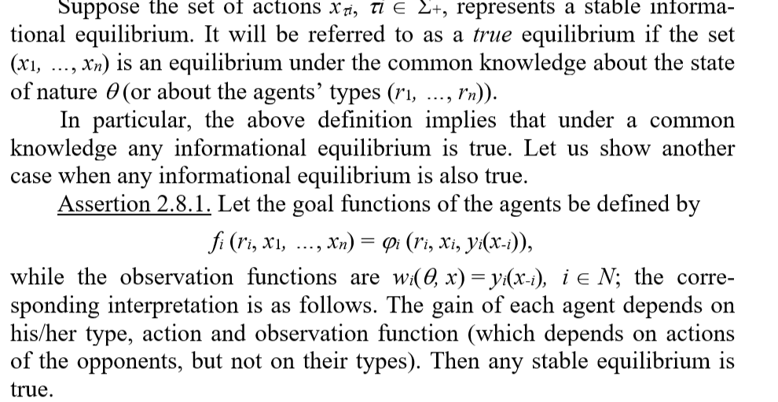

Slide 86
Part 3
Control problems

Slide 88
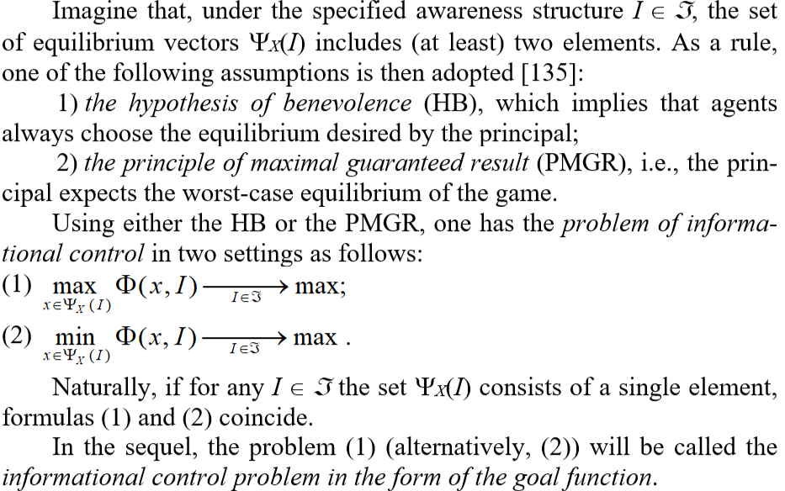

Slide 89
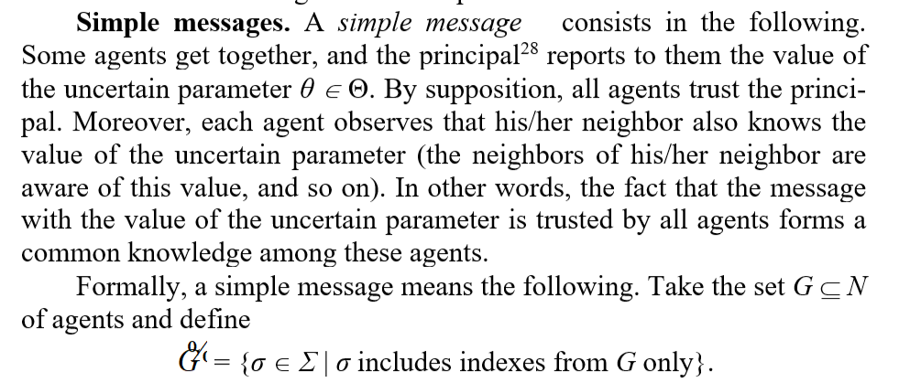

Slide 90
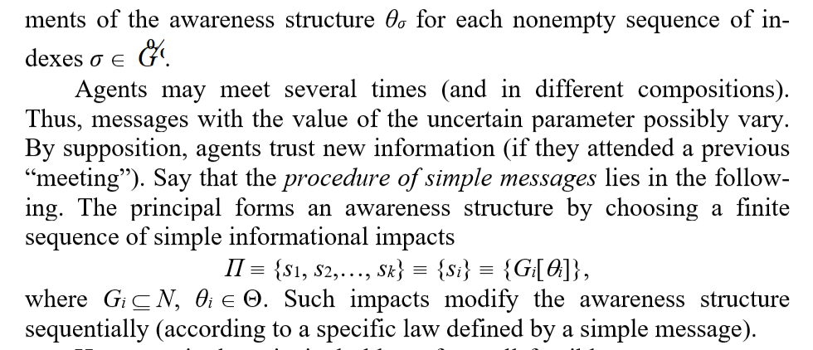

Slide 91
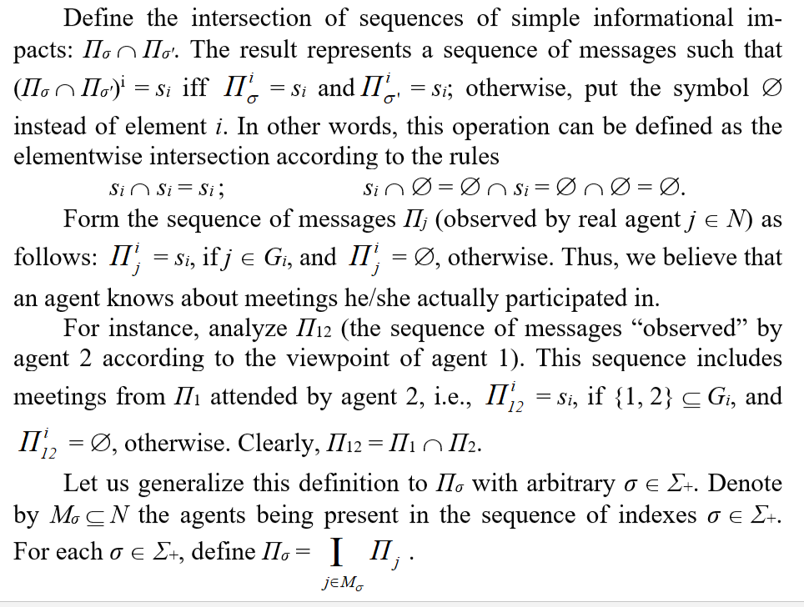

Slide 92
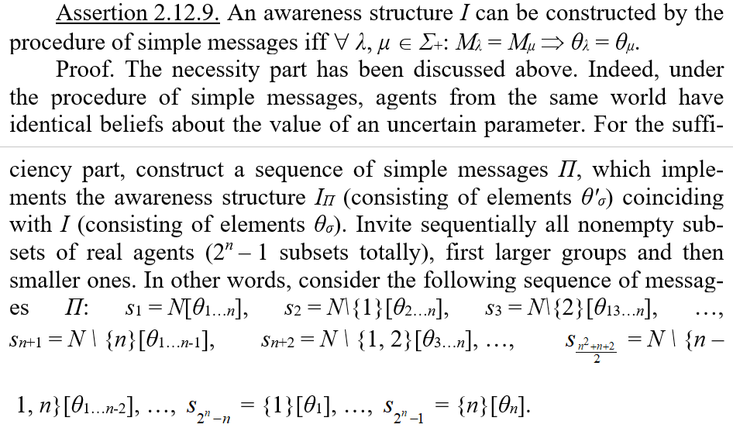

Slide 93
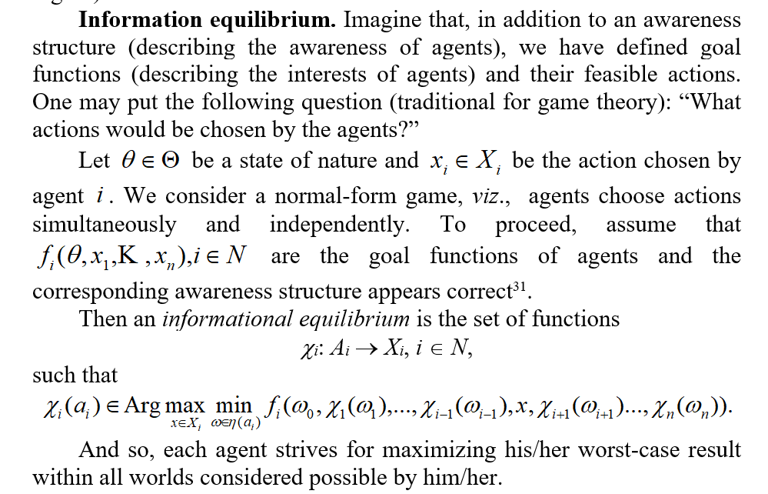

Slide 95
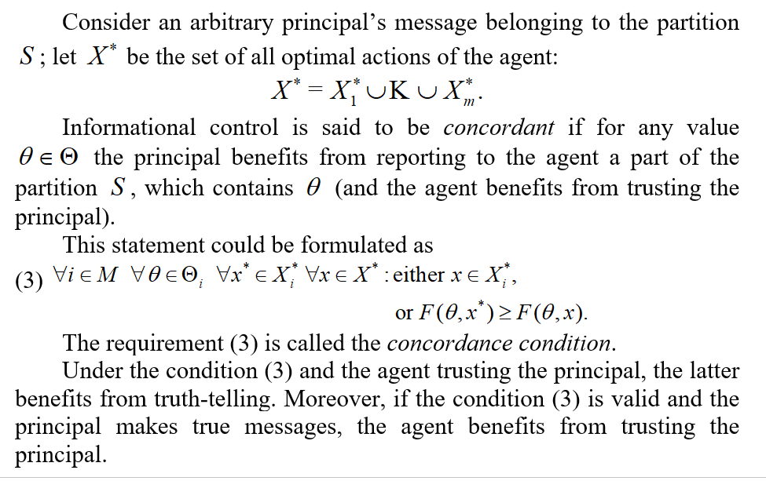

Slide 96
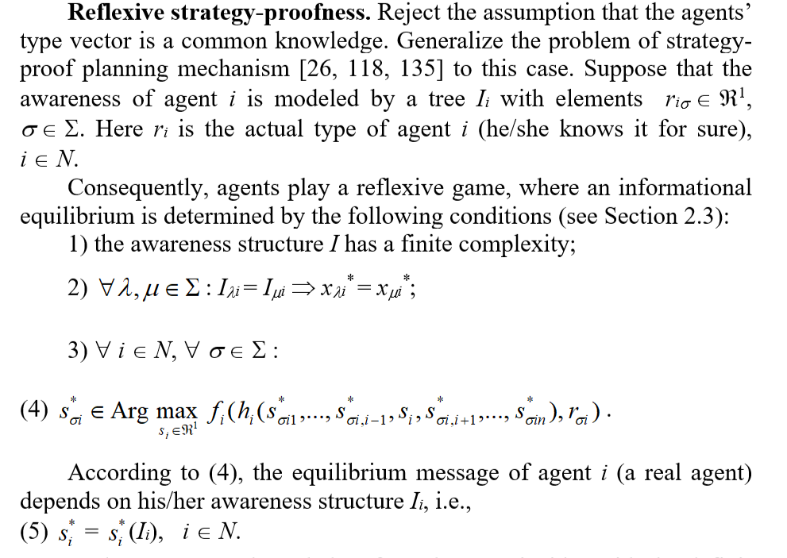

Slide 97
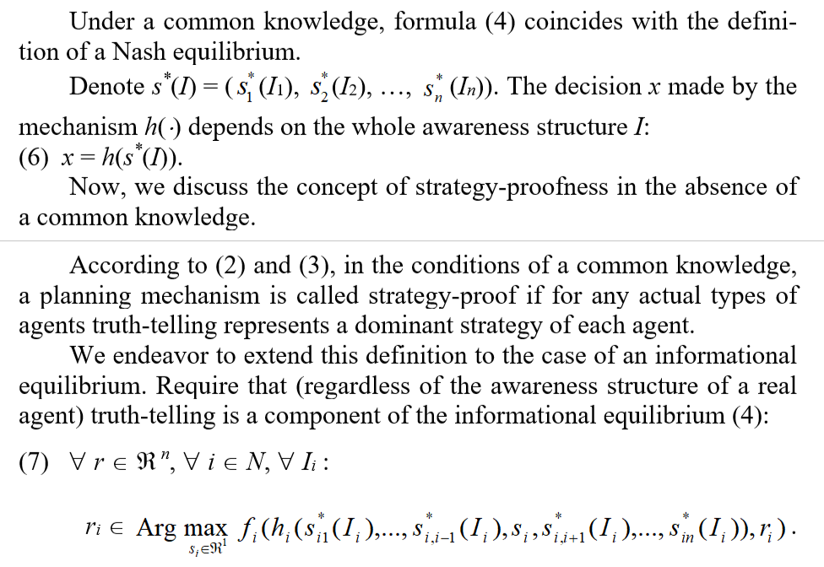

Slide 98
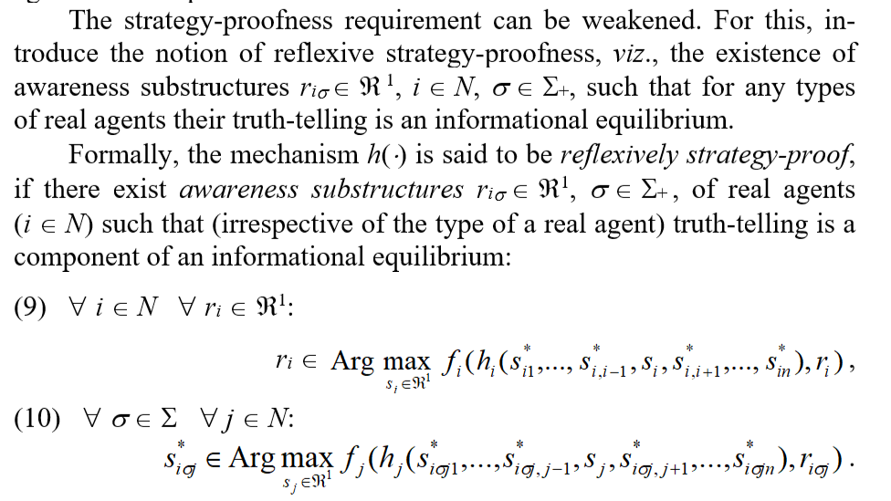

Slide 99
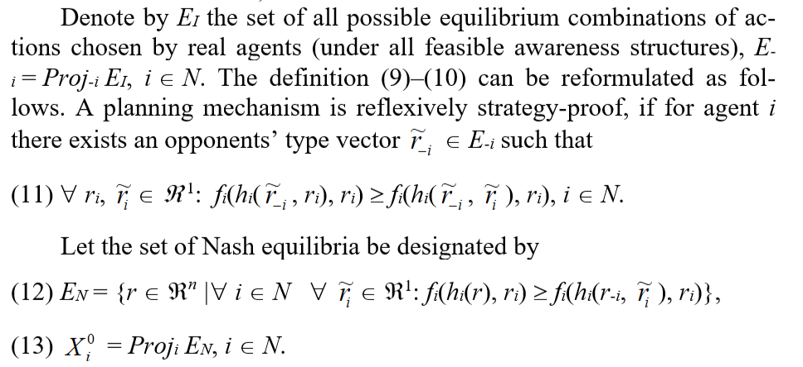

Slide 100
Question section

Slide 101
Thank you!

